Slide 1
A Seminar on Data Integrity Audit Scheme Based on Blockchain Expansion Technology
Team 10 :
G. Sairam (21EG505828)
J. Dayamani (21EG505831)
V. Likitha (21EG505870)
Project Supervisor
Dr. P. Ravinder Rao
Assistant Professor

Slide 2
Introduction
Cloud computing, a distributed model reliant on a shared virtualized computing resource pool, facilitates user access to robust computing and storage capabilities. While it alleviates the burden of data storage for users, challenges persist, particularly in security, reliability, and privacy. Ensuring the integrity of outsourced data becomes critical, given potential risks like data damage or deletion by cloud service providers (CSP). Current cybersecurity laws and traditional auditing schemes face shortcomings. Blockchain emerges as a solution with decentralization, tamper resistance, and traceability properties. However, its rapid growth poses maintenance challenges. A proposed data integrity verification scheme, utilizing blockchain expansion technology, addresses these issues through a protocol based on plasma smart contracts, a batch auditing scheme, and rigorous security analysis. Experiments demonstrate the efficiency and effectiveness of the proposed scheme.

Slide 3
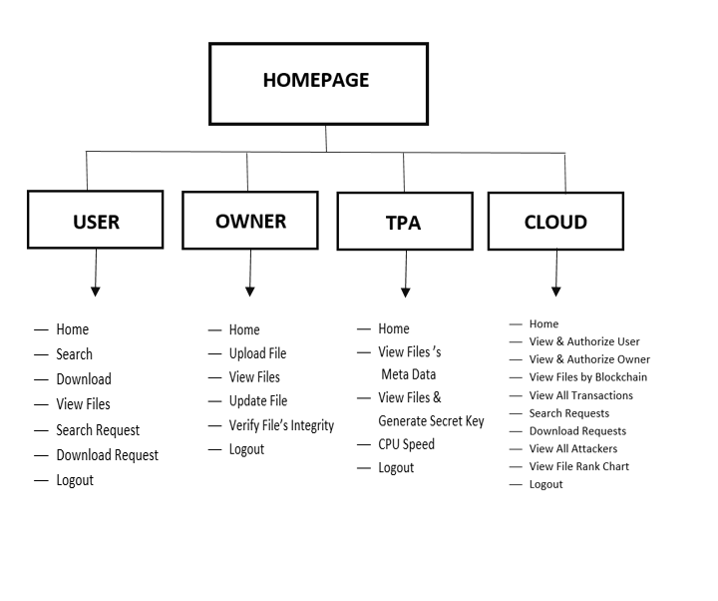
Concept Tree

Slide 4
Literature
Author(s) | Strategies | Advantages | Disadvantages
Y. Fan, X. Lin, G. Tan, Y. Zhang, W. Dong and J. Lei (2019) | Threshold scheme for secure key management, supporting dynamic data operations. It aims to eliminate reliance on Third-Party Auditors (TPA) and associated costs. | Threshold scheme enhances key management, reducing the risk of key leakage and ensuring the security of cryptographic operations. | Threshold scheme is complex to manage and distributing cryptographic keys could pose challenges, particularly in scenarios with a large number of users or files.
Q. Zhou, H. Huang, Z. Zheng and J. Bian (2020) | The project classifies scalability solutions into two layers - Layer1 (on-chain) and Layer2 (off-chain). | Introduces a method to partition the block-chain into smaller shards, enabling parallel processing of transactions. | Changing the consensus mechanism, especially in established block-chain networks like Bitcoin, can face resistance and challenges in achieving widespread acceptance.

Slide 5
Literature(cont..)
Author(s) | Method | Advantages | Disadvantages
K. Xu, W. Chen and Y. Zhang (2021) | The verification tags are used to enable verification without exposing the actual data, providing a secure and privacy-preserving approach | The verification tags protect the confidentiality of the data by prevents exposure of sensitive details during the integrity verification process. | It requires knowledge on cryptographic principles & If key management practices are not robust, it could lead to key exposure.
G. Xie, Y. Liu, G. Xin and Q. Yang (2021) | The signature algorithm is used to sign the files on the user side. | Signature algorithm enhances the security of the system against potential threats. | The success or failure of the file upload process depends on the execution of smart contracts

Slide 6
Problem Statement
The increase in cloud data outsourcing faces a critical hurdle – ensuring data integrity. In the existing system, various methods like smart contracts, decentralization, and deduplication have been proposed to ensure data integrity in cloud storage. However, these lack robust data auditing techniques and effective hashing mechanisms. For instance, replacing Third Party Auditors (TPA) with smart contracts, falls short in resisting replay attacks by Cloud Service Providers (CSP). Some expansion schemes address blockchain scalability but overlook crucial elements like data auditing techniques and hashing processes, leaving potential vulnerabilities.

Slide 7
Problem Illustration
The surge in cloud data outsourcing encounters a significant challenge – guaranteeing data integrity. Existing solutions, such as smart contracts and decentralization, lack robust data auditing and hashing mechanisms. For instance, substituting Third Party Auditors (TPA) with smart contracts proves insufficient against replay attacks by Cloud Service Providers (CSP). Despite expansion schemes addressing blockchain scalability, essential elements like advanced data auditing and hashing processes are overlooked. This oversight creates potential vulnerabilities, emphasizing the urgent need for comprehensive solutions to safeguard data integrity in cloud storage amidst the growing reliance on outsourcing.

Slide 8
Proposed Method
The proposed system of this project introduces a data integrity audit protocol based on plasma smart contracts, leveraging plasma sub-chains to reduce main chain storage pressure. Batch auditing is implemented for efficient multi-task processing, employing non-interactive audits. A reward pool mechanism ensures correctness, and security analysis.

Slide 9
Proposed Method Illustration
In the existing system, various approaches such as smart contracts, decentralization, and duplication have been proposed to address data integrity concerns in cloud storage. However, these methods lack data auditing techniques and hashing mechanisms. The proposed system introduces a novel approach by implementing a data integrity audit protocol based on plasma smart contracts. Plasma sub-chains are introduced to alleviate main chain storage pressure, and a batch auditing scheme, featuring non-interactive audits and a reward pool mechanism, enhances efficiency. Security analysis and Ethereum blockchain experiments validate the proposed system, offering advantages like batch auditing and public data integrity verification.

Slide 10
Parameter
Cost Effectiveness: Assess the cost-effectiveness in terms of hardware, development and maintenance costs, considering potential savings in blockchain network maintenance.
Security Efficiency: Evaluate the system’s effectiveness in ensuring data security, focusing on prevention of unauthorized access, tampering, and vulnerabilities.
User Experience Improvement: Assess improvements in user experience through non-interactive audits, minimizing communication with CSP during data integrity audits.
Scalability: Evaluate the system’s scalability to handle increasing cloud data outsourcing, addressing the rapid growth of blocks in existing blockchain technology.

Slide 11
Experiment Environment
Hardware System Configuration:
Processor: Pentium IV
RAM: 4 GB (minimum)
Hard Disk: 20 GB
Software Requirements:
Operating System: Windows XP
Programming Language: Java or J2EE for frontend development
Blockchain Framework: Ethereum
Integrated Development Environment (IDE): Eclipse, IntelliJ IDEA, or Visual Studio Code.
Database: MySQL
Web Development: HTML, CSS, and JavaScript for frontend development if a user interface is required.

Slide 12
Project status
S.No | Functionality | Status (Completed /in-progress/Not started)
1. | Collection of Research Papers | Completed
2. | Design | Completed
3. | Code Implementation | Not Started
4. | Documentation | Not Started

Slide 13
References
Y. Fan, X. Lin, G. Tan, Y. Zhang, W. Dong and J. Lei, "One secure data integrity verification scheme for cloud storage", Future Gener. Comput. Syst., vol. 96, pp. 376-385, Jul. 2019.
Q. Zhou, H. Huang, Z. Zheng and J. Bian, "Solutions to scalability of blockchain: A survey", IEEE Access, vol. 8, pp. 16440-16455, 2020.
K. Xu, W. Chen and Y. Zhang, "Blockchain-based integrity verification of data migration in multi-cloud storage", J. Phys. Conf. Ser., vol. 2132, no. 1, Dec. 2021.
G. Xie, Y. Liu, G. Xin and Q. Yang, "Blockchain-based cloud data integrity verification scheme with high efficiency", Secur. Commun. Netw., vol. 2021, pp. 1-15, Apr. 2021.

Slide 14
Thank you

Slide 15
Project seminar–I Evaluation
S.No | Rubrics | Marks
1 | Concept Introduction | 4
2 | Literature and Parameter | 5
3 | Problem and Problem Illustration | 8
4 | Proposed Method and Illustration | 8
Total |  | 25

